Slide 1
Revision
Term 1

Slide 2
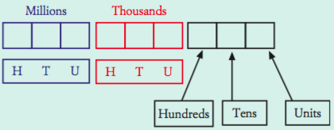
Value = how much it is worth
Place value = its place the house
5 3 2 0 9 4 1
number | Place value | value
2
4

Slide 3


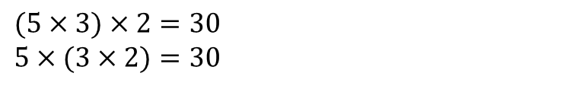

24
7
30
Date
The laws of numbers
EQ – Describe the commutative law and associative law
The order in which you multiply or add any two numbers does not change the result.
What is the commutative law?
$$6+9=15$$
$$9+6=15$$
$$5×7=35$$
$$7×5=35$$
The order in which three or more numbers are added or the order in which three or more numbers are multiplied is not important.
What is the associative law?
$$\left(6+5\right)+2=13$$
$$6+(5+2)=13$$
$$(5×3)×2=30$$
$$5×(3×2)=30$$
These laws do not apply to subtraction and division
5
Notes:
Lesson objective (EQ)

Slide 4
Calculate the following without a calculator
$7+32+13$
$2×17×5$
$293+568$

Slide 5
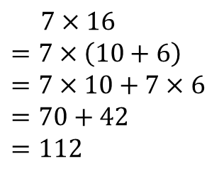
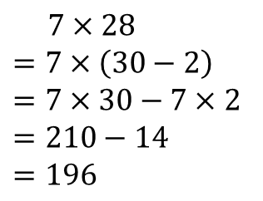
24
7
30
Date
Distributive law
EQ – Describe the distributive law.
How do I use the distributive law?
The distributive law allows us to multiply large numbers by splitting it up into tens and ones, then multiplying each part separately.
Examples
$$7×16$$
$$=7×\left(10+6\right)$$
$$=7×10+7×6$$
$$=70+42$$
$$=112$$
$$7×28$$
$$=7×\left(30−2\right)$$
$$=7×30−7×2$$
$$=210−14$$
$$=196$$
5
Notes:
Lesson objective (EQ)

Slide 6

Questions
$7×22$
$15×9$

Slide 7

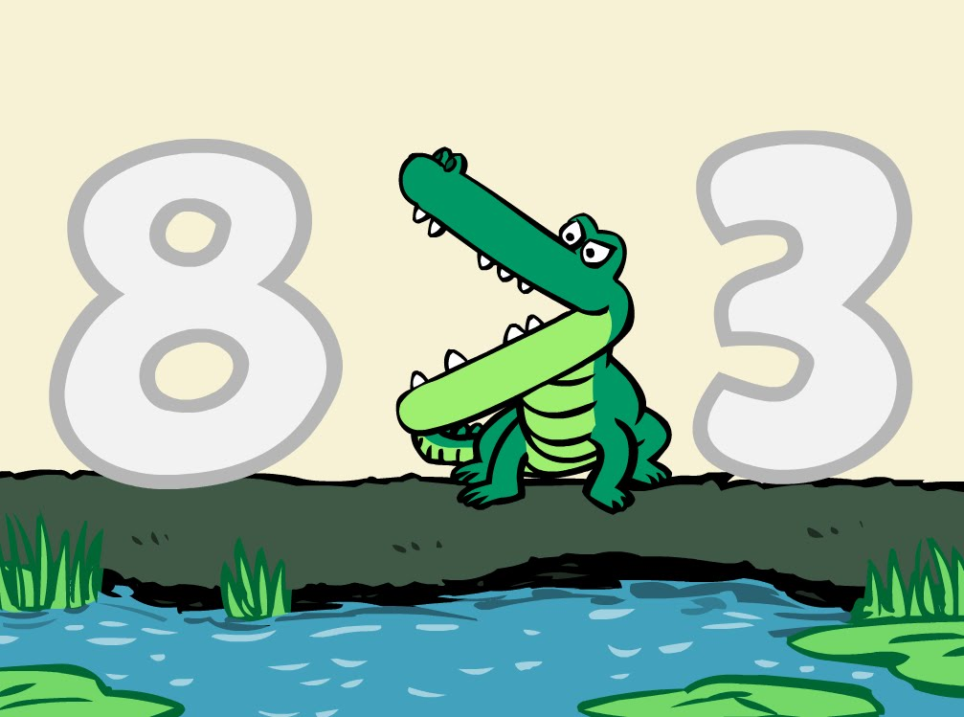
24
7
30
Date
Directed Numbers
EQ – What are directed numbers and how do they relate to integers?
Integers are represented by the number line
Negative
Positive
The closer to the right the BIGGER the number
-4 1
-1 8
3 -10

Slide 8

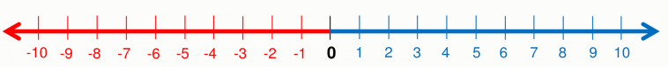
-2
4 + (-6) =

Slide 9

-2
4 + (-6) =
- 6 – (- 10) =
4

Slide 10
- 2
4 + (-6) =
- 6 – (- 10) =
- 1 – 8 =
4
- 9

Slide 11
- 2
4 + (-6) =
- 6 – (- 10) =
- 1 – 8 =
- 5 + 7 =
4
- 9
2

Slide 12
24
7
30
Date
BIMDAS
EQ – What is BIMDAS and how do we use it?
What are the rules of BIMDAS?
Order of Operations / BIMDAS
1. Brackets First
2. Indicies
3. Multiply and/or Divide
(from left to right)
4. Add or Subtract
(from left to right)
Let’s Try…
2 + $5 ×\left(8 − 2\right) =$
2 + $5 ×6 =$
2 + $30=$
32

Slide 13
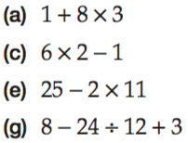
Your Turn

Slide 14
Calculate the following
$1^{2}=1×1=1$
$2^{2}$
$3^{2}$
$4^{2}$
$5^{2}$
$6^{2}$
$7^{2}$
$8^{2}$
$9^{2}$
${10}^{2}$
${11}^{2}$
${12}^{2}$

Slide 15
Calculate the following
$\sqrt{1}=1$
$\sqrt{4}=$
$\sqrt{9}=$
$\sqrt{16}=$
$\sqrt{25}=$
$\sqrt{36}=$
Extention
$\sqrt{400}=$
$\sqrt{49}=$
$\sqrt{64}=$
$\sqrt{81}=$
$\sqrt{100}=$
$\sqrt{121}=$
$\sqrt{144}=$
$\sqrt{2500}=$

Slide 16

24
7
30
Date
Factors
EQ – How do I find the HCF of two numbers?
What is a factor?
The numbers that divide exactly into another number with no remainder.
How do I find the factors of a 15?
Find the numbers that multiply to give 15.
$$1×15$$
$$3×5$$
Then list. The factors of 15 are 1,3,5,15
What is the HCF?
Highest Common factor
How do I find the HCF of two numbers?
List the factors of both numbers.
Then find the highest number in both lists.
Find the HCF of 8 and 20
Factors of 8 – 1, 2, 4, 8
Factors of 20 -1, 2, 4, 5, 10, 20
So the HCF of 8 and 20 is 4
Example

Slide 17
Your turn
  a) Write down the factors of 12
b) Write down the factors of 18
c) Find the HCF off 12 and 18

Slide 18
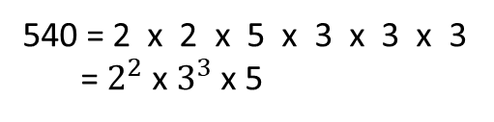
24
7
30
Date
Prime Factorisation
EQ – How do I write numbers as a product of prime factors?
How do I find the prime factors?
Use a factor tree to write 540 as a product of prime factors.
Find 2 numbers x to give 540
540
Circle any primes
prime
2
270
Continue dividing until all factors are prime
prime
2
135
27
5
prime
prime
3
9
Write the primes in ascending order
prime
3
3
prime
540 = 2 x 2 x 5 x 3 x 3 x 3
= $2^{2}$ x $3^{3}$ x 5

Slide 19
Task
Let’s work through another example together.
Write 84 as a product of prime factors

